Slide 1
Parking Helper
Ben Halim, Haejoon Choi, Scott Lai, Maria Baltasar

Slide 2

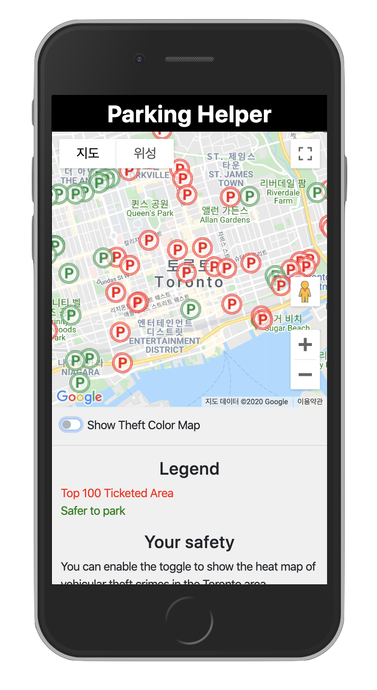
Parking Helper
Safe
Inexpensive
Nearby

Slide 3
Parking Helper
Easy to view locations
Rated locations
Information for surrounding area

Slide 4
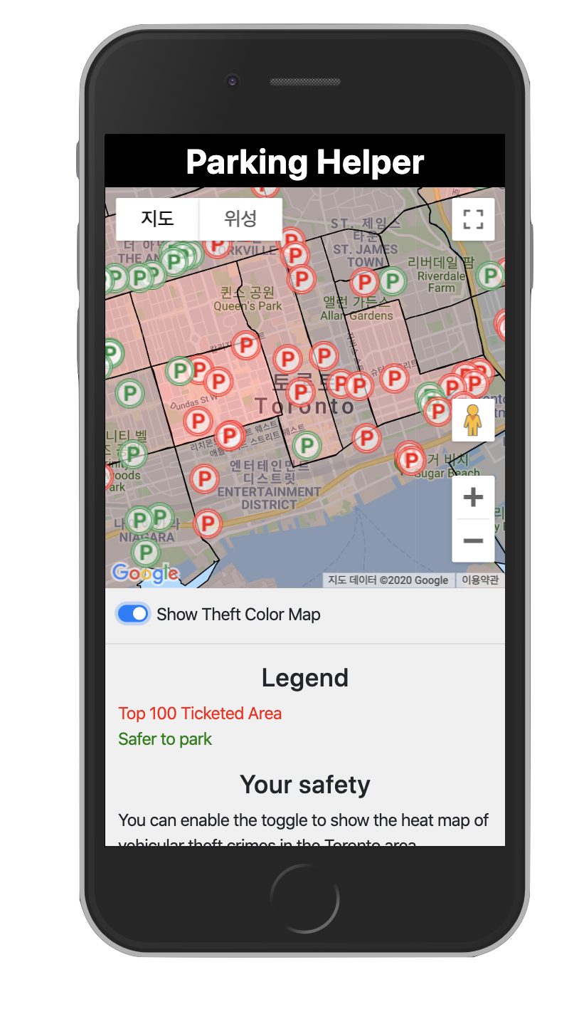
Parking Helper
Shows vehicular crime

Slide 5
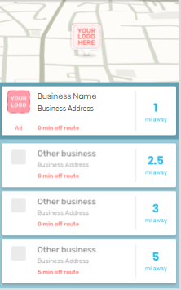
Parking Helper
Businesses can advertise to locations they are near

